Slide 1
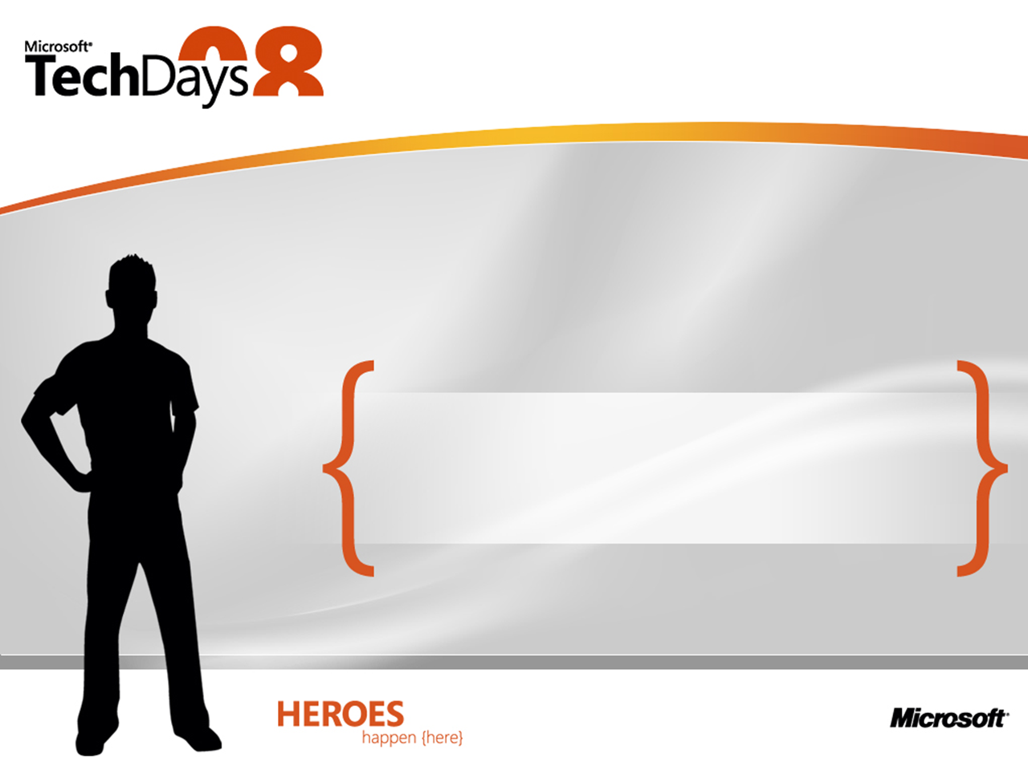


Laurent Bugnion
Senior Software Engineer
Siemens Building Technologies
Notes:
© 2007 Microsoft Corporation. All rights reserved. Microsoft, Windows, Windows Vista and other product names are or may be registered trademarks and/or trademarks in the U.S. and/or other countries.
The information herein is for informational purposes only and represents the current view of Microsoft Corporation as of the date of this presentation. Because Microsoft must respond to changing market conditions, it should not be interpreted to be a commitment on the part of Microsoft, and Microsoft cannot guarantee the accuracy of any information provided after the date of this presentation.
MICROSOFT MAKES NO WARRANTIES, EXPRESS, IMPLIED OR STATUTORY, AS TO THE INFORMATION IN THIS PRESENTATION.

Slide 2



Slide 3


Laurent Bugnion
Senior Software Engineer
Siemens Building Technologies
12 years software development
6 years .NET
(ASP.NET, C#, WinForms)
2 years WPF
Microsoft MVP (Client App Dev)
http://www.galasoft.ch
Notes:
© 2007 Microsoft Corporation. All rights reserved. Microsoft, Windows, Windows Vista and other product names are or may be registered trademarks and/or trademarks in the U.S. and/or other countries.
The information herein is for informational purposes only and represents the current view of Microsoft Corporation as of the date of this presentation. Because Microsoft must respond to changing market conditions, it should not be interpreted to be a commitment on the part of Microsoft, and Microsoft cannot guarantee the accuracy of any information provided after the date of this presentation.
MICROSOFT MAKES NO WARRANTIES, EXPRESS, IMPLIED OR STATUTORY, AS TO THE INFORMATION IN THIS PRESENTATION.

Slide 4


Slide 5

Building comfort
  Building automation and control system
  Room management; temperature, lighting, blinds
Fire safety
  Fire detection, Automatic extinguishing, Danger management
  Danger management, Voice evacuation
Electronic security
  Access control, intrusion detection
  Video surveilliance
Notes:
© 2007 Microsoft Corporation. All rights reserved. Microsoft, Windows, Windows Vista and other product names are or may be registered trademarks and/or trademarks in the U.S. and/or other countries.
The information herein is for informational purposes only and represents the current view of Microsoft Corporation as of the date of this presentation. Because Microsoft must respond to changing market conditions, it should not be interpreted to be a commitment on the part of Microsoft, and Microsoft cannot guarantee the accuracy of any information provided after the date of this presentation.
MICROSOFT MAKES NO WARRANTIES, EXPRESS, IMPLIED OR STATUTORY, AS TO THE INFORMATION IN THIS PRESENTATION.

Slide 6












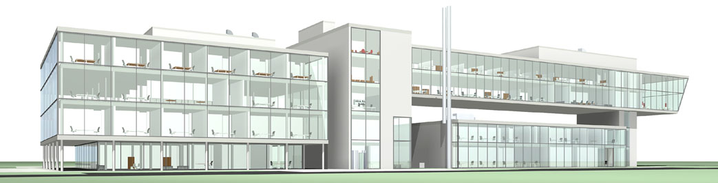













Total Building Solution
Telephony
Firewall
Public key
infra-structure
Network
and
content security
Net-
working
Meta-
directory
Track & trace
Risk
manage-
ment
Security
assess-
ment
Consulting
IT process
integration
Training
Communications and IT security
IT process integration
Management station
Management station
Management station
Fire
Intrusion
Access
Video
Time
Evacuation
Scanning
Venti-lation
Heating
AC
Light
Water
Power
Security & safety
Building automation

Slide 7


Slide 8
Managed client
  Rapid prototyping
  Rapid development
  Safe code
  …
Graphical challenges
  Skinning, Controls
  Unified styles "Siemens Corporate“, Siemens font…
  Animations (also color animations, fade-in, etc…)
  Gradients, Opacities, Chromeless windows
  No limits to creativity
Notes:
© 2007 Microsoft Corporation. All rights reserved. Microsoft, Windows, Windows Vista and other product names are or may be registered trademarks and/or trademarks in the U.S. and/or other countries.
The information herein is for informational purposes only and represents the current view of Microsoft Corporation as of the date of this presentation. Because Microsoft must respond to changing market conditions, it should not be interpreted to be a commitment on the part of Microsoft, and Microsoft cannot guarantee the accuracy of any information provided after the date of this presentation.
MICROSOFT MAKES NO WARRANTIES, EXPRESS, IMPLIED OR STATUTORY, AS TO THE INFORMATION IN THIS PRESENTATION.

Slide 9
Bleeding edge
  Motivation factor for key developers
  Perfect timing
Community spirit
  Blogs
  Forums, Newsgroups
Industry experts
  Microsoft
  IdentityMine
  Siemens Corporate Research
Notes:
© 2007 Microsoft Corporation. All rights reserved. Microsoft, Windows, Windows Vista and other product names are or may be registered trademarks and/or trademarks in the U.S. and/or other countries.
The information herein is for informational purposes only and represents the current view of Microsoft Corporation as of the date of this presentation. Because Microsoft must respond to changing market conditions, it should not be interpreted to be a commitment on the part of Microsoft, and Microsoft cannot guarantee the accuracy of any information provided after the date of this presentation.
MICROSOFT MAKES NO WARRANTIES, EXPRESS, IMPLIED OR STATUTORY, AS TO THE INFORMATION IN THIS PRESENTATION.

Slide 10


Slide 11
Expression Blend
  Enables the designer-developer workflow
  Visual Design Tool, produces « real » code
  High integration with Visual Studio
  Not « just » a designer tool
Model – View – ViewModel pattern (MVVM)
  Data-driven User Interface
  Excellent to Unit Test your UI
Notes:
© 2007 Microsoft Corporation. All rights reserved. Microsoft, Windows, Windows Vista and other product names are or may be registered trademarks and/or trademarks in the U.S. and/or other countries.
The information herein is for informational purposes only and represents the current view of Microsoft Corporation as of the date of this presentation. Because Microsoft must respond to changing market conditions, it should not be interpreted to be a commitment on the part of Microsoft, and Microsoft cannot guarantee the accuracy of any information provided after the date of this presentation.
MICROSOFT MAKES NO WARRANTIES, EXPRESS, IMPLIED OR STATUTORY, AS TO THE INFORMATION IN THIS PRESENTATION.

Slide 12
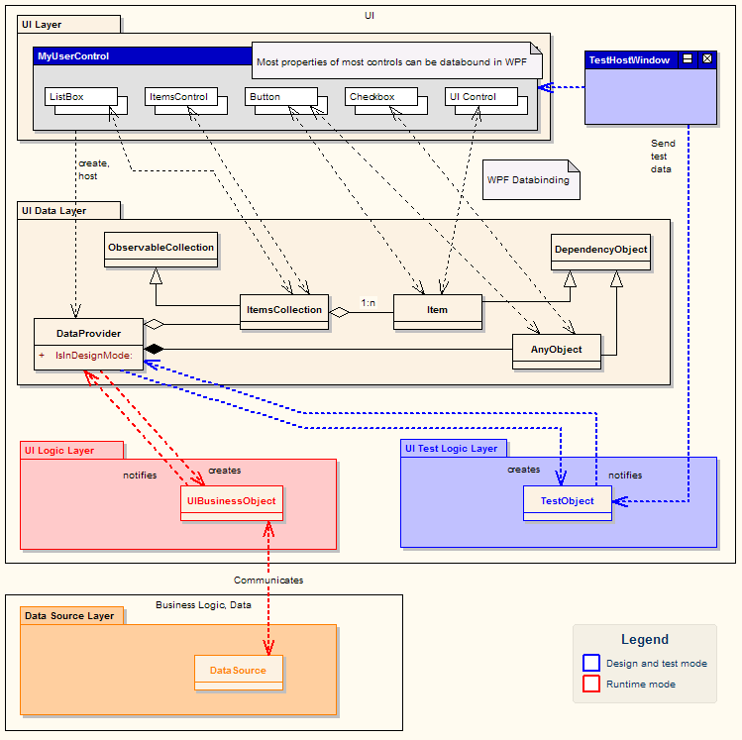

Client Architecture
View

ViewModel

Model
Design
/ Test
Notes:
© 2007 Microsoft Corporation. All rights reserved. Microsoft, Windows, Windows Vista and other product names are or may be registered trademarks and/or trademarks in the U.S. and/or other countries.
The information herein is for informational purposes only and represents the current view of Microsoft Corporation as of the date of this presentation. Because Microsoft must respond to changing market conditions, it should not be interpreted to be a commitment on the part of Microsoft, and Microsoft cannot guarantee the accuracy of any information provided after the date of this presentation.
MICROSOFT MAKES NO WARRANTIES, EXPRESS, IMPLIED OR STATUTORY, AS TO THE INFORMATION IN THIS PRESENTATION.

Slide 13


Slide 14

New role for Designers
  They are now part of the development team
  They create code
    Wireframes, « Business Analyst », « User Interface Designer »
    UX, « User Experience Designer »
    XAML assets, « Production Artist »
New role for Developers
  Give up UI ownership
  Learn to speak designer-ish
  Concentrate on View Model and on Model
Notes:
© 2007 Microsoft Corporation. All rights reserved. Microsoft, Windows, Windows Vista and other product names are or may be registered trademarks and/or trademarks in the U.S. and/or other countries.
The information herein is for informational purposes only and represents the current view of Microsoft Corporation as of the date of this presentation. Because Microsoft must respond to changing market conditions, it should not be interpreted to be a commitment on the part of Microsoft, and Microsoft cannot guarantee the accuracy of any information provided after the date of this presentation.
MICROSOFT MAKES NO WARRANTIES, EXPRESS, IMPLIED OR STATUTORY, AS TO THE INFORMATION IN THIS PRESENTATION.

Slide 15
A new role: The WPF Integrator
  Communicator, Translator
  Coach and Teacher, Passion for WPF and UI
  Contact to Microsoft
A new role: The UI Custodian
  Owns the UI
  Problem domain wizard
  Mediator between Product Owners and Interaction Designers
Notes:
© 2007 Microsoft Corporation. All rights reserved. Microsoft, Windows, Windows Vista and other product names are or may be registered trademarks and/or trademarks in the U.S. and/or other countries.
The information herein is for informational purposes only and represents the current view of Microsoft Corporation as of the date of this presentation. Because Microsoft must respond to changing market conditions, it should not be interpreted to be a commitment on the part of Microsoft, and Microsoft cannot guarantee the accuracy of any information provided after the date of this presentation.
MICROSOFT MAKES NO WARRANTIES, EXPRESS, IMPLIED OR STATUTORY, AS TO THE INFORMATION IN THIS PRESENTATION.

Slide 16


Slide 17
WPF fits well with Agile development
Do not underestimate the importance of design
  "Developers can do it": No they cannot, it's not their job!
Do not let the integrator role become a bottleneck
Have respect for the learning curve.
  Train your developers early
Notes:
© 2007 Microsoft Corporation. All rights reserved. Microsoft, Windows, Windows Vista and other product names are or may be registered trademarks and/or trademarks in the U.S. and/or other countries.
The information herein is for informational purposes only and represents the current view of Microsoft Corporation as of the date of this presentation. Because Microsoft must respond to changing market conditions, it should not be interpreted to be a commitment on the part of Microsoft, and Microsoft cannot guarantee the accuracy of any information provided after the date of this presentation.
MICROSOFT MAKES NO WARRANTIES, EXPRESS, IMPLIED OR STATUTORY, AS TO THE INFORMATION IN THIS PRESENTATION.

Slide 18

© 2007 Microsoft Corporation. All rights reserved. Microsoft, Windows, Windows Vista and other product names are or may be registered trademarks and/or trademarks in the U.S. and/or other countries.
The information herein is for informational purposes only and represents the current view of Microsoft Corporation as of the date of this presentation. Because Microsoft must respond to changing market conditions, it should not be interpreted to be a commitment on the part of Microsoft, and Microsoft cannot guarantee the accuracy of any information provided after the date of this presentation.
MICROSOFT MAKES NO WARRANTIES, EXPRESS, IMPLIED OR STATUTORY, AS TO THE INFORMATION IN THIS PRESENTATION.
Notes:
© 2007 Microsoft Corporation. All rights reserved. Microsoft, Windows, Windows Vista and other product names are or may be registered trademarks and/or trademarks in the U.S. and/or other countries.
The information herein is for informational purposes only and represents the current view of Microsoft Corporation as of the date of this presentation. Because Microsoft must respond to changing market conditions, it should not be interpreted to be a commitment on the part of Microsoft, and Microsoft cannot guarantee the accuracy of any information provided after the date of this presentation.
MICROSOFT MAKES NO WARRANTIES, EXPRESS, IMPLIED OR STATUTORY, AS TO THE INFORMATION IN THIS PRESENTATION.

